Slide 1
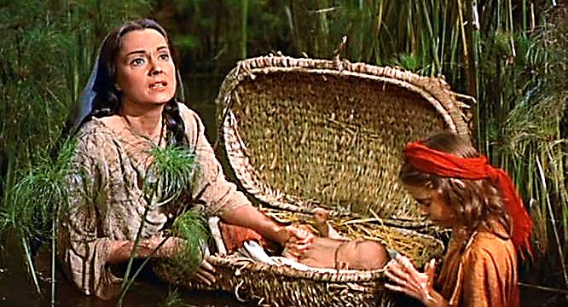
Moses, the Baby God Saved
Jesus Will Always Rise Again

Slide 2
Note: Any videos in this presentation will only play online. After you download the slideshow, you will need to also download the videos from YouTube & add them back into your PowerPoint.
We present these messages at Bee Creek Park in College Station, TX. If you would like to watch the video of the service with this message, click here:
http://campaignkerusso.org/?p=10249
We would love to know more about the people who download our lessons & sermons. We invite you to email us & let us know where & how you use them.
info@ckbrazos.org

Slide 3
Next Slide → Song: Go Down Moses Download Here: https://www.youtube.com/watch?v=vf6jBP4YXwo

Slide 4
Next Slide → Song: Pharaoh Pharaoh Download Here: https://www.youtube.com/watch?v=ktn_gECxauY

Slide 5
Next Slide → Video: Moses in a Basket Download Here: https://www.youtube.com/watch?v=MZ-BbFQ3K1A

Slide 6
Next Slide → Video: Baby Moses Download Here: https://www.youtube.com/watch?v=qOKHCiMaV0c

Slide 7
Moses, the Baby God Saved
Jesus Will Always Rise

Slide 8
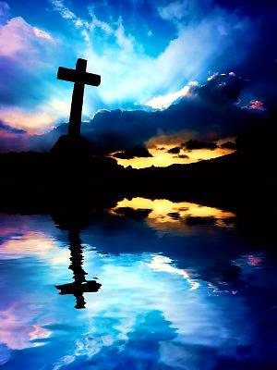
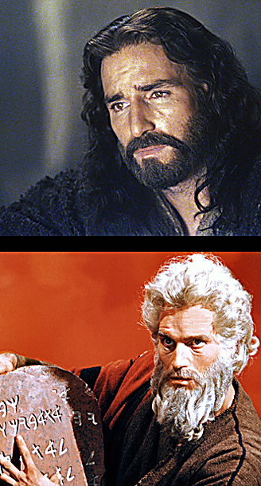
Jesus is Like Moses
Moses said:
“The Lord your God will send you a prophet, an Israelite like me. You must listen to him.”
Deut. 18:15

Slide 9
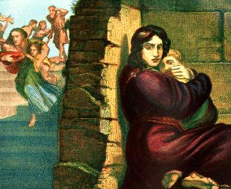
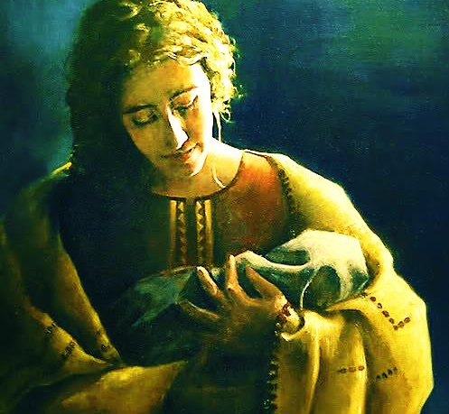
Because Jesus would come from the Jews & would one day destroy Satan, Moses & Jesus were both a threat to Satan. He used evil leaders to try & destroy them as babies.
“Herod...was very angry. He sent men to kill all the young boys two years old and under in Bethlehem.” Mat. 2:19
“Then Pharaoh told all his people, ‘Throw every son who is born to the Hebrews into the Nile. But keep every daughter alive.’” Exodus 1:22

Slide 10
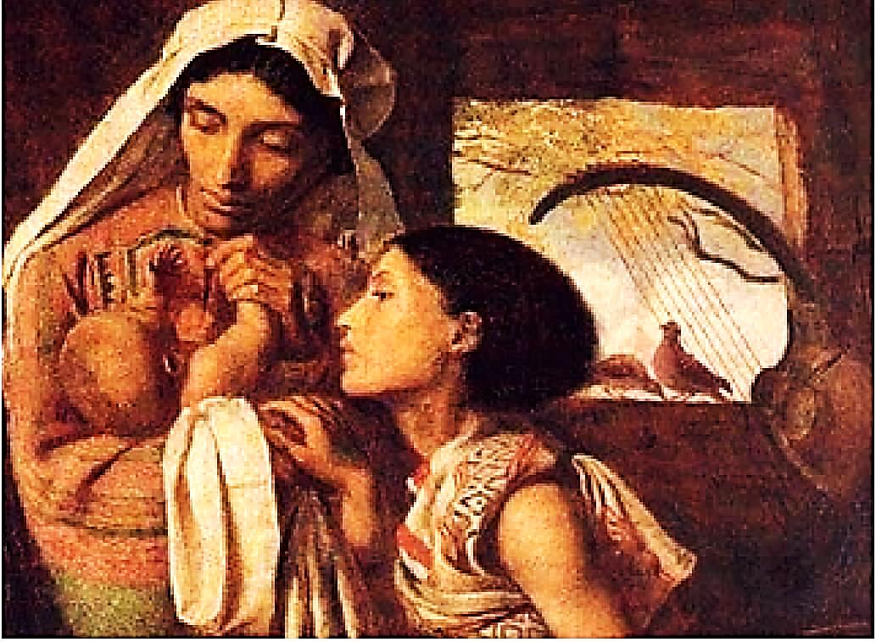
Moses’ Mother & Sister Tried to Save Him
“When she saw that he was beautiful, she hid him for three months. But the time came when she could hide him no longer. So she took a basket made from grass, and covered it with tar and put the child in it. And she set it in the grass by the side of the Nile. His sister stayed to watch and find out what would happen to him.” Ex 2:2-4

Slide 11
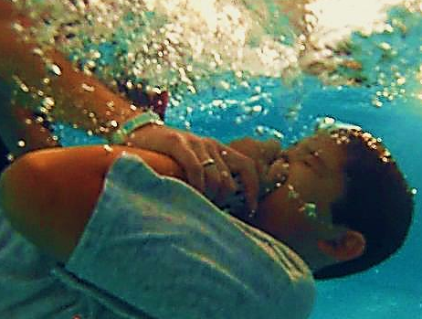
In the Bible, Water is often a Picture of death
Passing through water is a symbol of passing through death :
Noah’s Ark
Water Baptism

Slide 12
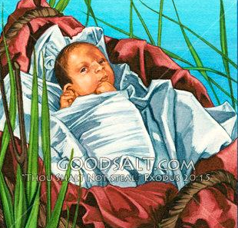
Moses’ little Ark in the Nile River is a picture of Jesus in the grave – Passing through death then rising. This passing through water (death) and coming up alive would happen again later in Moses’ Life – In a BIG WAY!

Slide 13
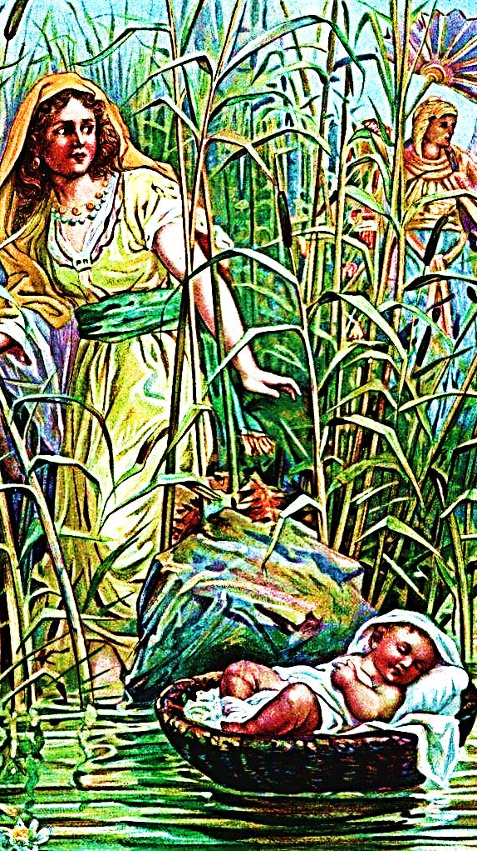
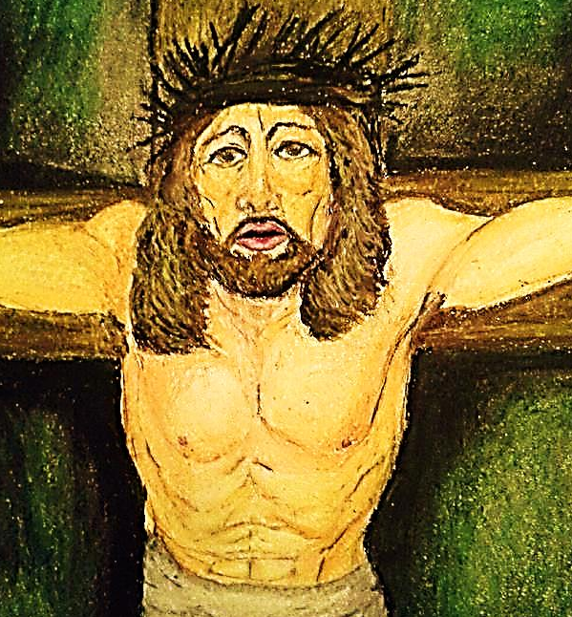
Just as Jesus was innocent when He died on the cross…
Moses was an innocent when he went into the water – He didn’t deserve death.

Slide 14
As the infant, Moses was sent to the Egyptians to start his life’s mission,
Christ also was sent to Egypt:
“…an angel of the Lord came to Joseph in a dream. He said, “Get up. Take the young Child and His mother to the country of Egypt." Mat. 2:13

Slide 15
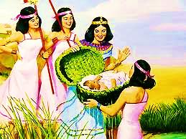
Like Jesus, Moses was resurrected (from the water/death) by a person in high authority – He didn’t raise Himself.
“But God raised Him from the dead.” Acts 13:30

Slide 16
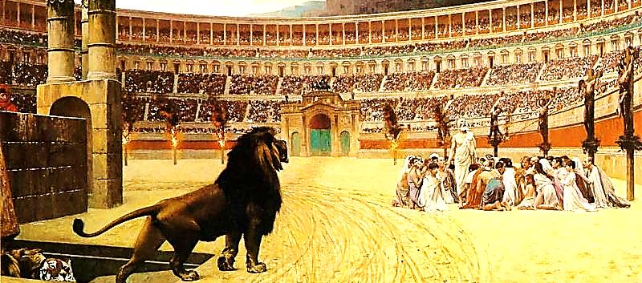
Jesus Always Rises!
As they tried to kill Moses and baby Jesus, as they did kill adult Jesus, they also tried to kill the Church. Most of the Apostles and Hundreds of Christians have been murdered, but Christianity always rises.

Slide 17
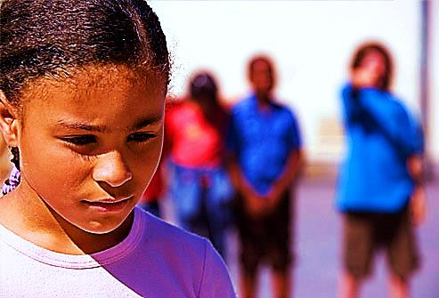
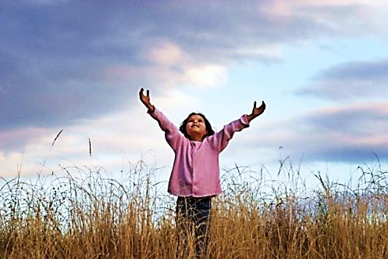
The enemy of Moses & Jesus is also our enemy. He would like to destroy our faith.
Our Christian faith may be attacked, but it cannot be destroyed – Jesus (in us) will always…
RISE AGAIN !

Slide 18
What is the Sinner‘s Prayer?
This is a prayer we can pray when we are ready to admit we are sinners and need Christ’s forgiveness.
It must be prayed with faith in our hearts and a readiness to have a life-changing encounter with Jesus Christ.

Slide 20
John Wesley’s Testimony
“…the preacher was describing the change which God works in the heart through faith in Christ and I felt my heart strangely warmed.”
Disciple’s Testimony
“They said to each other, ‘Did not our hearts burn within us while he talked to us on the road, while he opened to us the Scriptures?’”

Slide 21
A prayer of faith → Pray this prayer if :
If you never have before
You have in the past, but you think it would mean more today
You have been walking afar off and you want to come back
You want to set an example & show others how it is done
You just like to give your heart to Jesus again & again
Faith

Slide 22
We Declare Our Faith Publicly Because Jesus Declared His LOVE Publicly
“If you stand before others and are willing to say you believe in me, then I will tell my Father in heaven that you belong to me.” Mat 10:32

Slide 23
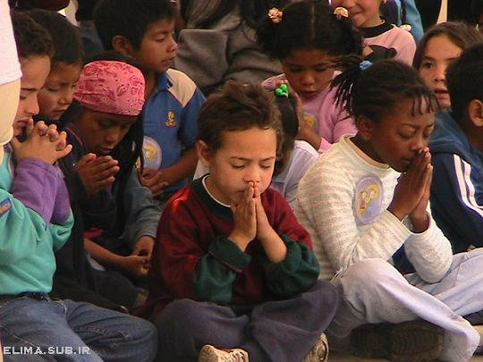
Dear Jesus,
I know I am a sinner & need your forgiveness.
I believe you died for my sins.
I now turn from sin.
Come into my heart I pray.
Do you want to meet Jesus as your savior right now?
Do you believe He died to save you from your sins & that He rose from the dead?
Do you believe that He is waiting to save you right now?

Slide 24
“But some people did accept him. They believed in him, and he gave them the right to become children of God.” John 1:12

Slide 26
“If you openly say, ‘Jesus is Lord’ and believe in your heart that God raised him from death, you will be saved.”
Rom. 10:9
What did you learn today?
What is the meaning of the name-tag?
What have you neen thinking about God lately?
What do you want to tell the world about Jesus?

Slide 27
“Draw near to God, and He will draw near to you…
…Cleanse your hands, you sinners, and make your hearts pure, you who are half-hearted towards God.” James 4:8 WNT

Slide 28
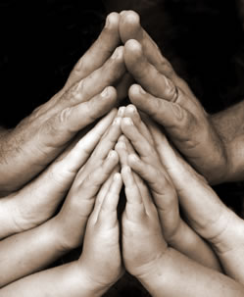
Close in Prayer

Slide 29
Note: Any videos in this presentation will only play online. After you download the slideshow, you will need to also download the videos from YouTube & add them back into your PowerPoint.
We present these messages at Bee Creek Park in College Station, TX. If you would like to watch the video of the service with this message, click here:
http://campaignkerusso.org/?p=10249
We would love to know more about the people who download our lessons & sermons. We invite you to email us & let us know where & how you use them.
info@ckbrazos.org

Slide 30
Welcome to Aggieland Faith Family Style Worship

Slide 31
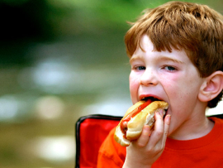
CURRENT SCHEDULE: See www.Aggielandfaith.org
SATURDAY —
At Bee Creek Park
2:00-4:00pm: Through the bible with felt-board stories – plus hot-dogs & drinks
SUNDAY —
At Bee Creek Park
2:00-4pm: Free snacks, drinks, kids crafts, prizes, singing & bible preaching

Slide 32
Would You Like Prayer or Bible Study at Your House?
Personal Prayer: We can come to your home & pray with you, or you can email us when you need prayer.
Home Bible Study: We will come to your home & hold a bible study for you & your friends.
Bible Party: We will hold a Kid’s Bible Party: You provide the food & kids - we will do the bible fun & stories.

Slide 33
Would You Like Visitation?
We will visit a friend, loved one in the hospital or in prison to pray for them & share Christ with them.
Contact: info@aggielandfaith.org

Slide 34
www.aggielandfaith.org
Go here to see pictures & videos
Go here to subscribe to e-mails about changes & cancellations

Slide 35
Note: Any videos in this presentation will only play online. After you download the slideshow, you will need to also download the videos from YouTube & add them back into your PowerPoint.
We present these messages at Bee Creek Park in College Station, TX. If you would like to watch the video of the service with this message, click here:
http://campaignkerusso.org/?p=10249
We would love to know more about the people who download our lessons & sermons. We invite you to email us & let us know where & how you use them.
info@ckbrazos.org

